Slide 1
Women's Soccer
Mariah Bastos
St. Thomas University
CIS- 545- 11 Data Warehousing
Professor Victor Karamalis
27th of April, 202

Slide 2
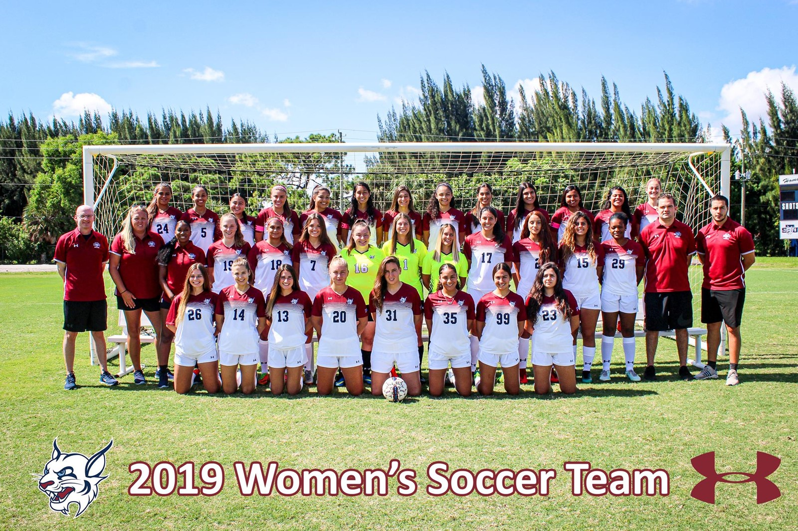

Slide 3
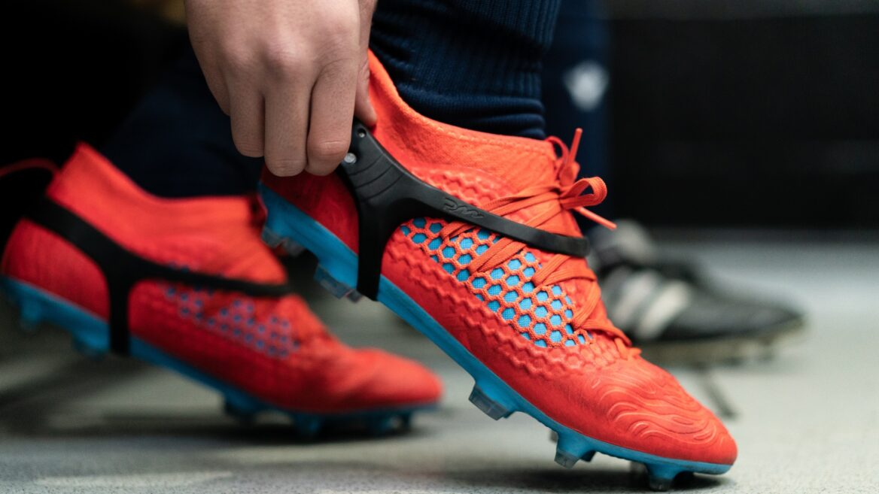
Player Maker Sensors
PlayerMaker
Videos

Slide 4
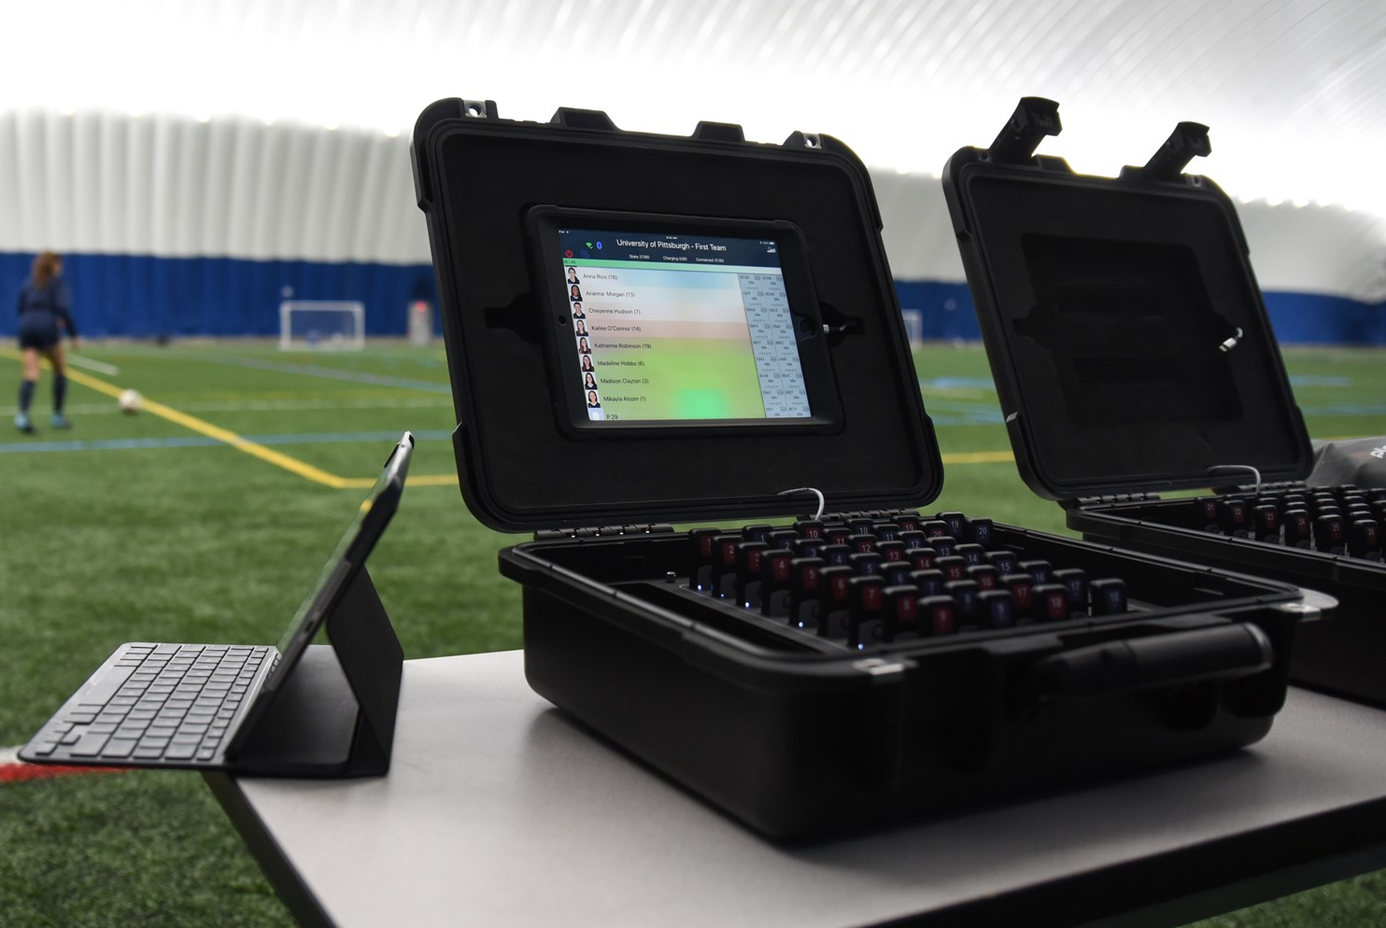

Slide 5
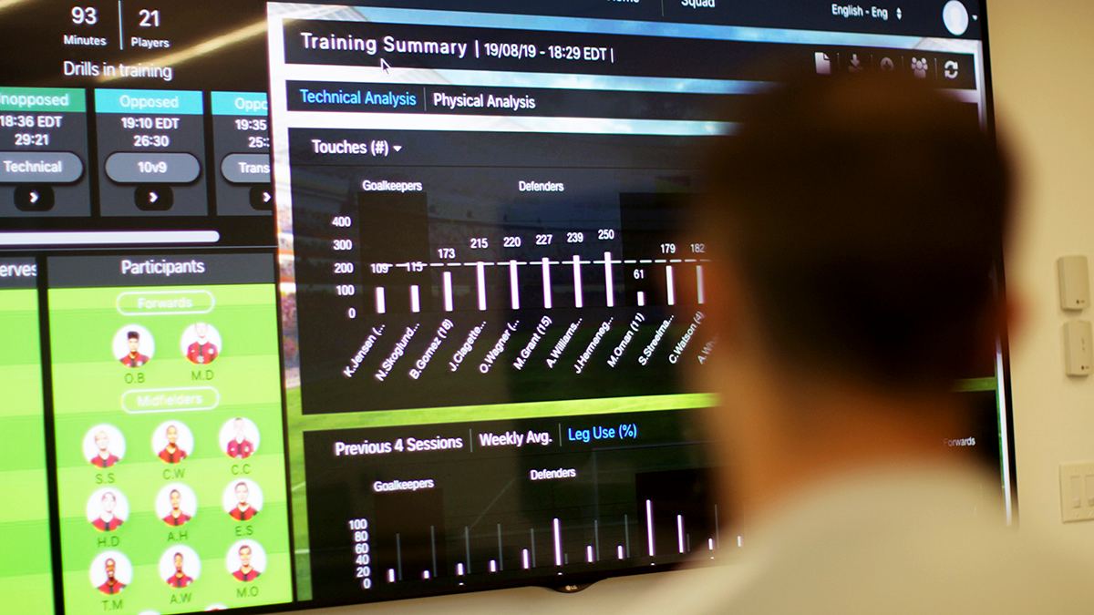
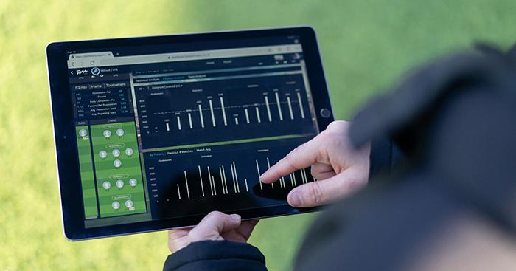
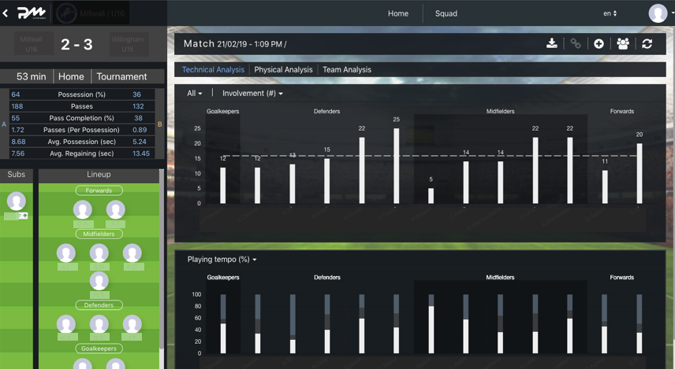

Slide 6
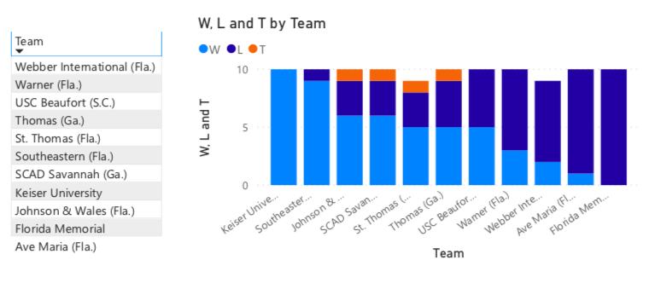
The Problem
St. Thomas University Women's Soccer don't exploit their full potential
They don't win many games even though they have a good team
Coaches don't know how to make sense of the data

Slide 7
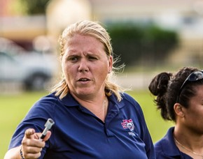
Who Is Affected
Soccer team
Coaches
Athletes
Athletic Department
School Reputation

Slide 8
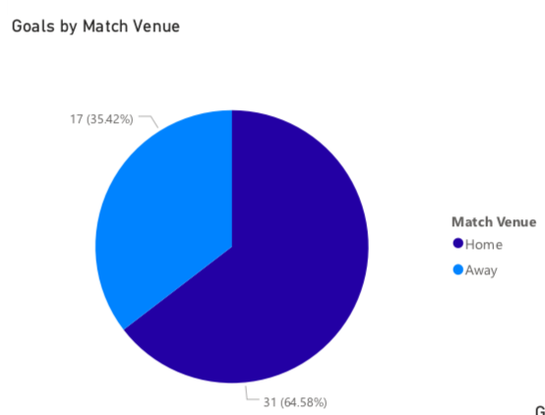
Goal 1: Finishing
The first idea is to practice more intensively finishing, specially in away games.

Slide 9
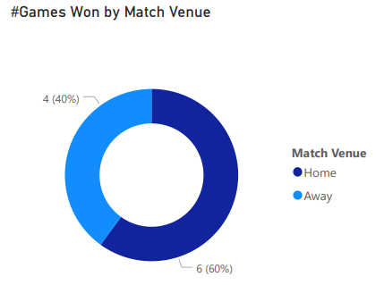
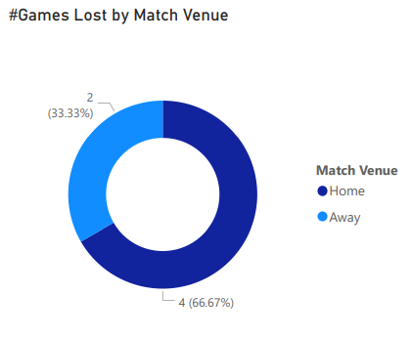

Slide 10
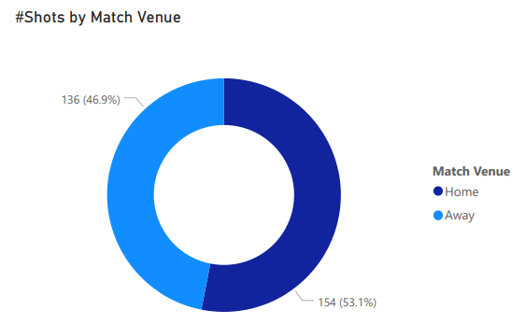
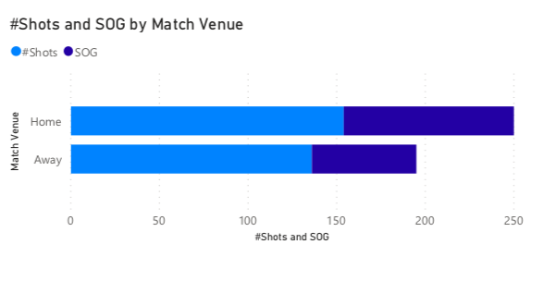

Slide 11
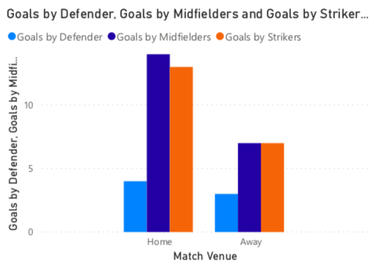

Slide 12
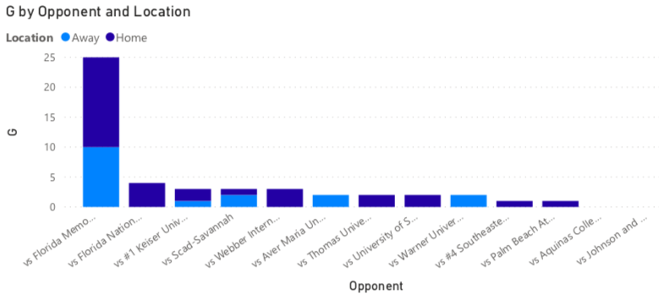
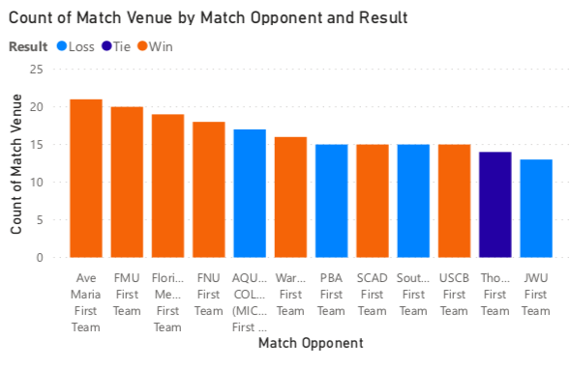
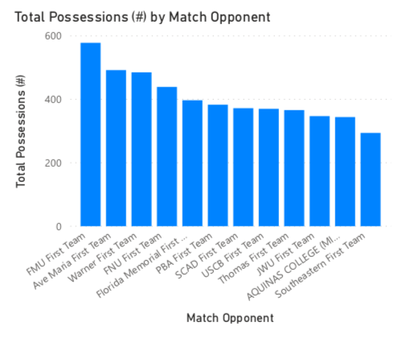

Slide 13
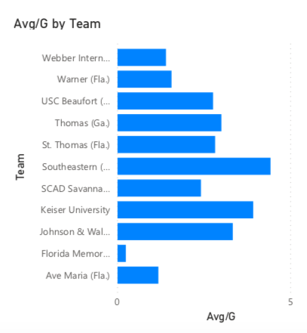
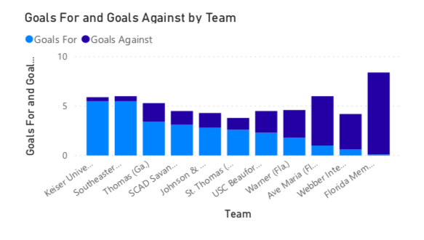

Slide 14
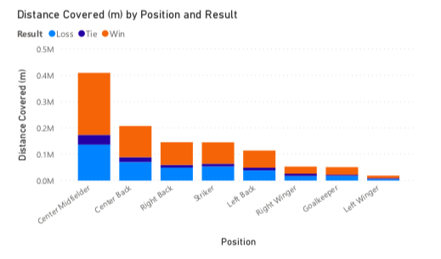
Goal 2: Improve Distance covered per Position

Slide 15
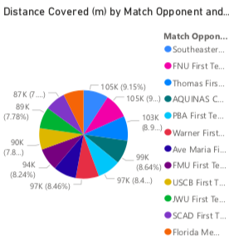
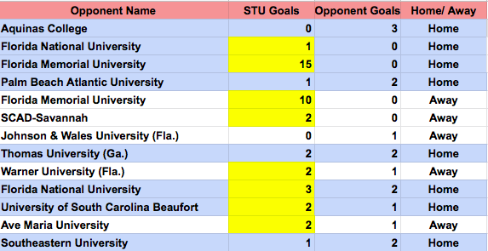

Slide 16
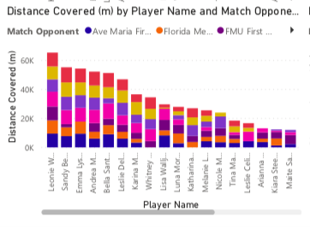
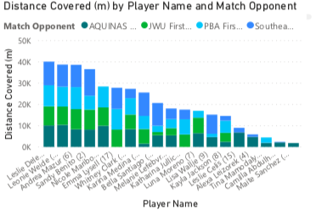

Slide 17
Goal 3: Improve fitness

Slide 18
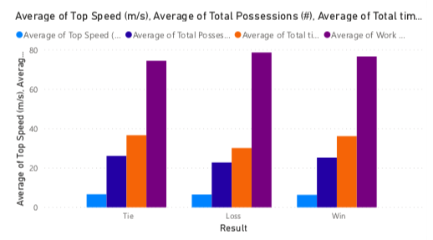

Slide 19
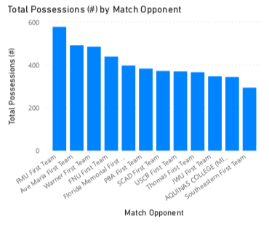
Goal 4: Ball Possession on Losing Games

Slide 20
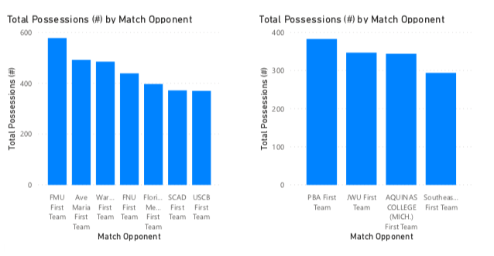

Slide 21
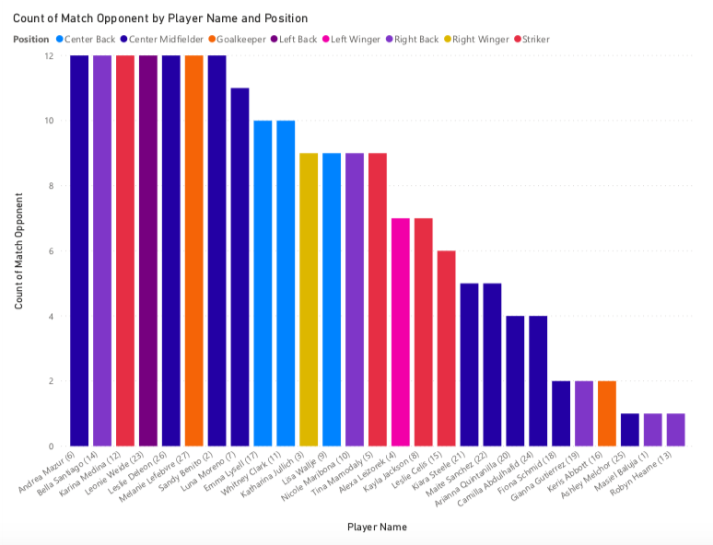
Goal 5: Improve Center- Midfielders

Slide 22
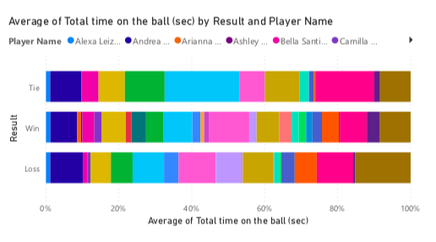

Slide 23
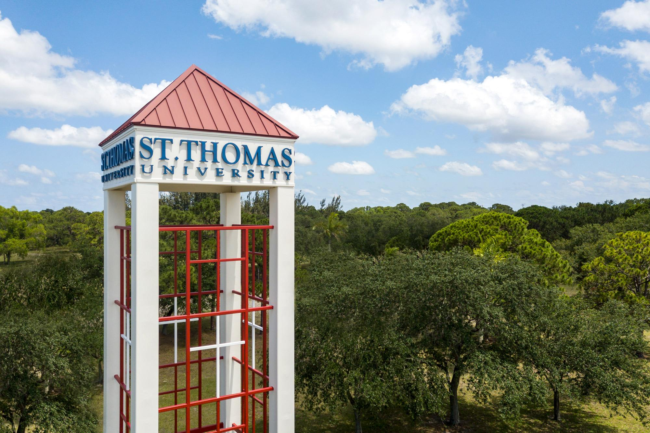
Where
Saint Thomas University Women's Soccer Team

Slide 24
When (timeline)
Data gathered during 2019 soccer season.
August 23rd- October 25th.
The changes should be implemented in the seasons to come.

Slide 25


Slide 26
Thank you!

